Slide 1
How Mobile-Vydya Apps For Patients Change The mHealth Trends

Slide 2


Mobile technologies make many aspects of our lives easier – that is its main purpose.
Healthcare is not an exception, and year after year more hospital begin to adopt technologies to become more advanced and effective.

Slide 3
The M-Vydya Trend
The term M-Vydya appeared not so long ago, but it has already grown into an impressive global industry of medical mobile app development.
The main trend is a precision-based model when it comes to mobile healthcare.

Slide 4
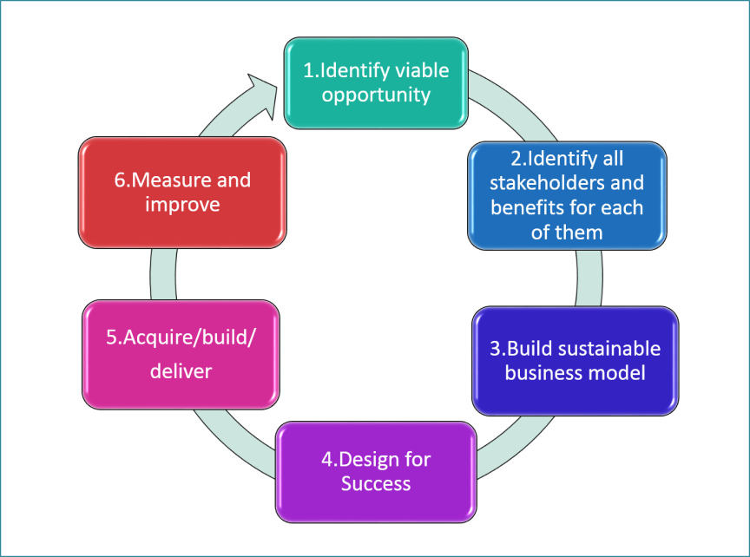
Benefits of M-Vydya
By using mobile devices in the healthcare setting, practices have the potential to enhance productivity, lower failure-to-respond rates, increase information access & communication.
This technology has become popular over the last few years.

Slide 5
Medical App Classification
The market of mHealth can seem overwhelming.
It’s no surprise, as there are lots of apps, and it can sometimes be hard to understand their purposes and possibilities.
Chronic care management apps.
Medical apps.
Healthcare and fitness apps.
Women’s health apps.
Medication management apps.
Personal health record apps.
Patient education apps.

Slide 6

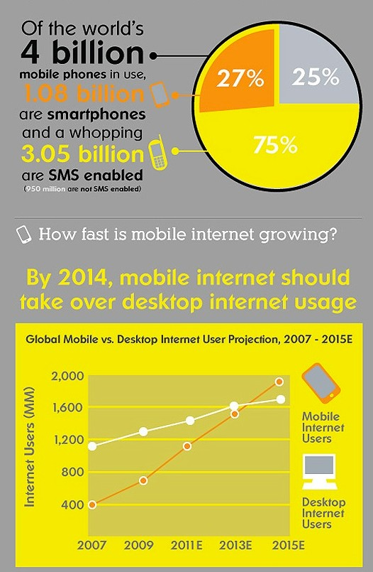
The future of Mobile device usage

Slide 7

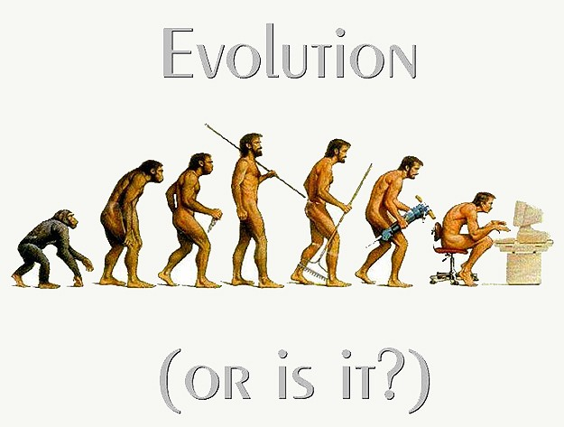
Evolution of Mobile Devices in healthcare
Started with laptops and PDAs
Netbooks became an inexpensive option
Tablets, smartphones and mobile devices have emerged on the market

Slide 8
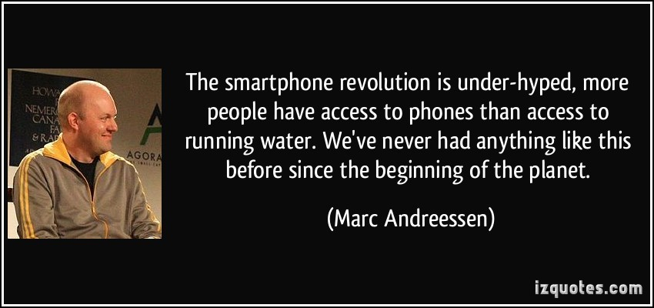

Slide 9

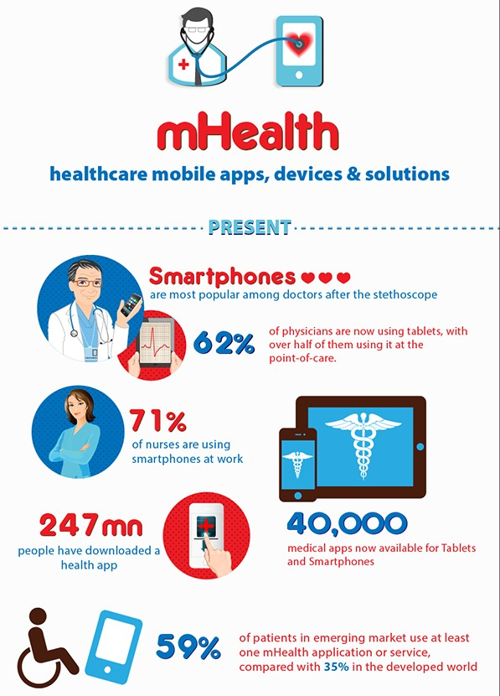
M-Vydya impact in Healthcare

Slide 10
What’s the goal of M-Vydya ?
To improve the delivery of healthcare!
Improve quality and access
Care-coordination
Lower rehospitalizations
Improve outcomes
Lower infection rates
Monitor patient status in real time
...Unrealized possibilities!

Slide 11
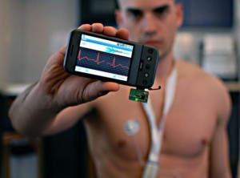
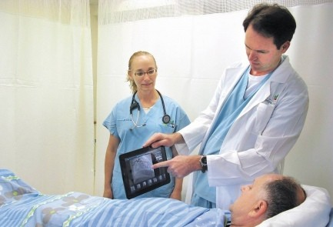
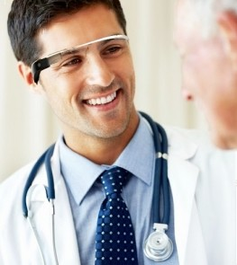
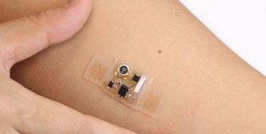
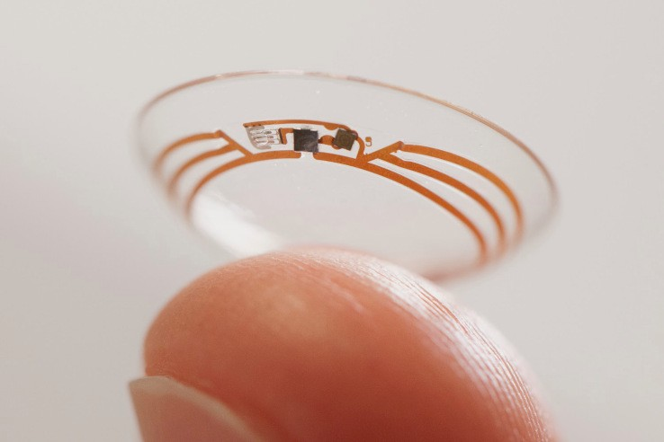
Types of M-Vydya technology
Tablets
Smart phones
Apps
Wearbles
Implantables

Slide 12
Tablets
Maximize portable technology in the patient encounter
Point of Care documentation
Real-time care coordination
Labs & Imaging
Patient education
Therapy benefits
Access to past medical history
Countless additional benefits

Slide 13
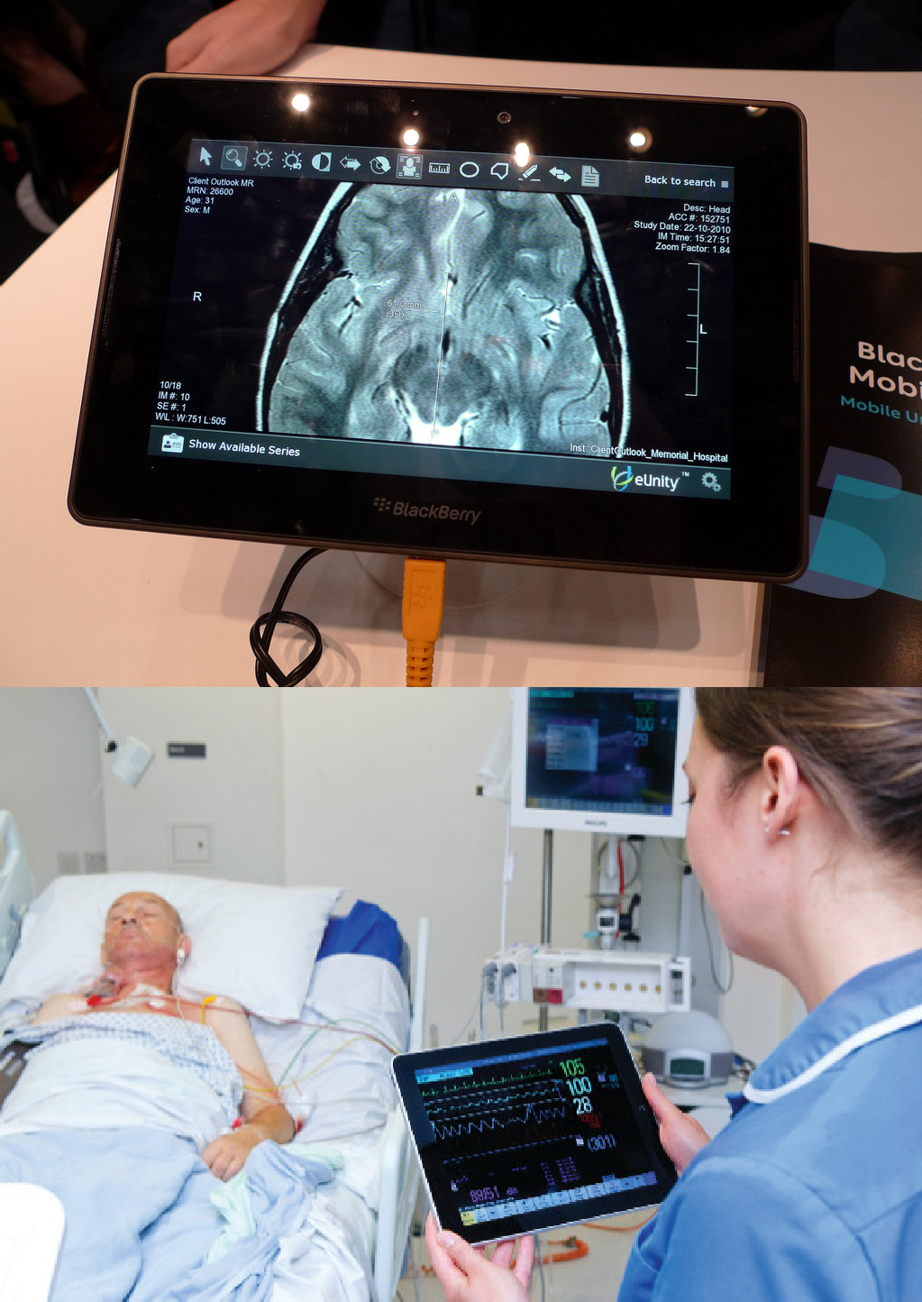
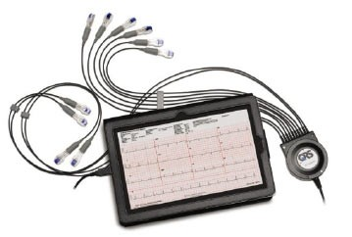

Slide 14
Smartphones
Smartphones are ubiquitous in healthcare
Care coordination
External device connection for testing and diagnostics
Blood pressure monitoring
Blood glucose levels
Use of smart apps

Slide 15
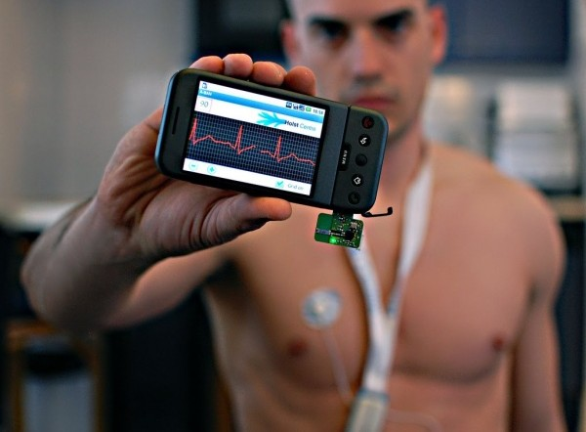
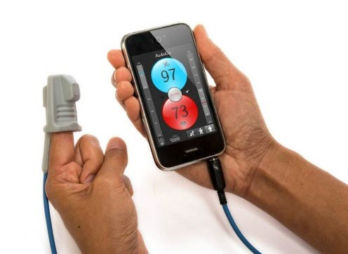
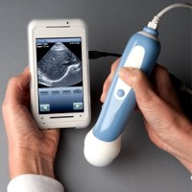
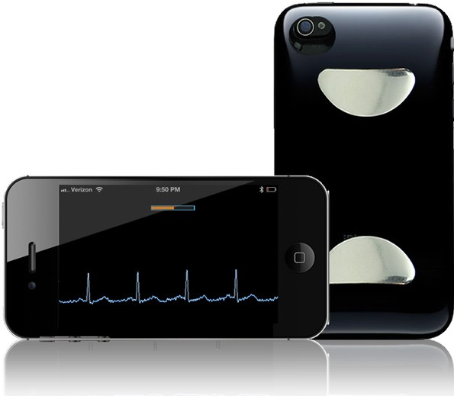

Slide 16
M-Vydya Apps
mHealth Apps have a wide range in scope
Online apps or on a device
Health & wellness
Diagnostic and testing
Patient education
Labs & Imaging
Social Media integration

Slide 17
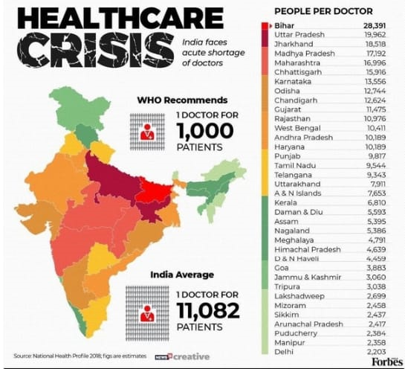
Health map in india

Slide 18
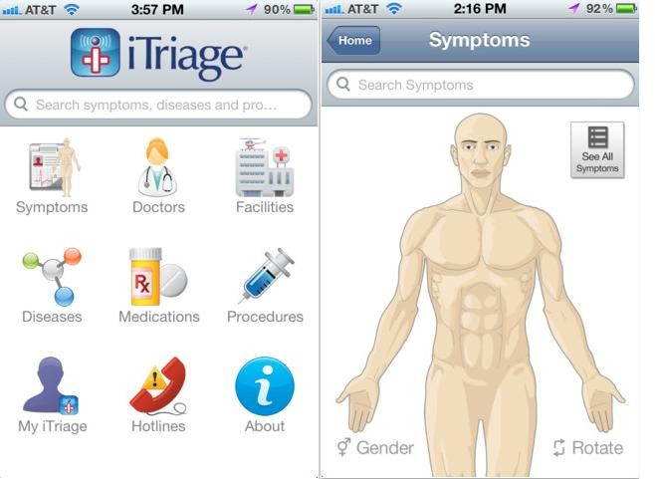
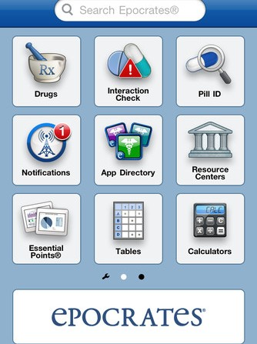
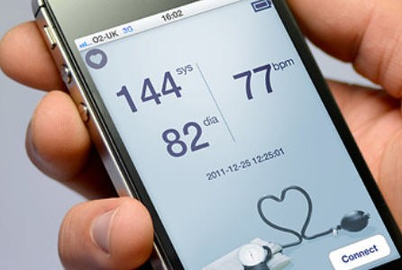
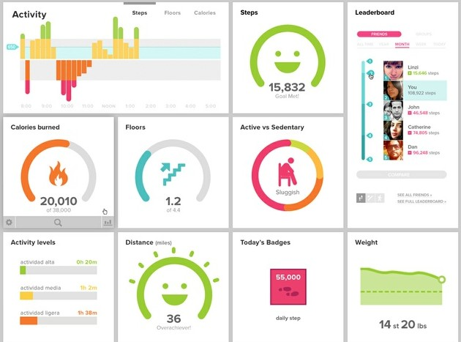
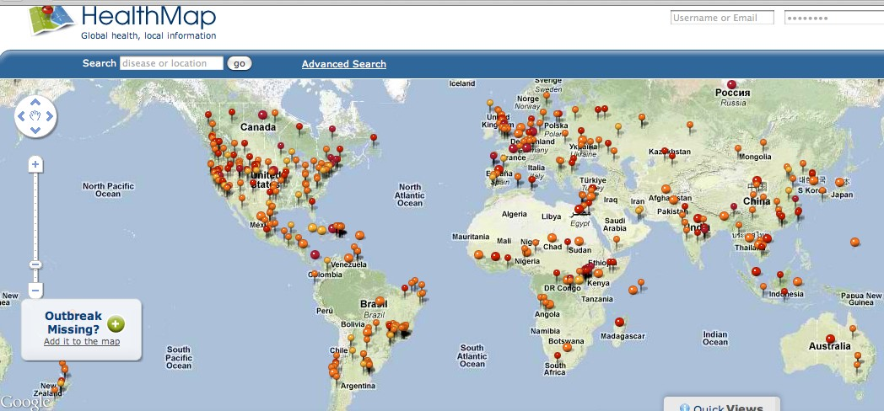

Slide 19
Wearables
Most popular in the personal fitness space
Track and trend activity levels
Sense & analyze information from substances emitted from transdermal source.
Use social media to enhance user accountability. “Peer pressure” effect

Slide 20
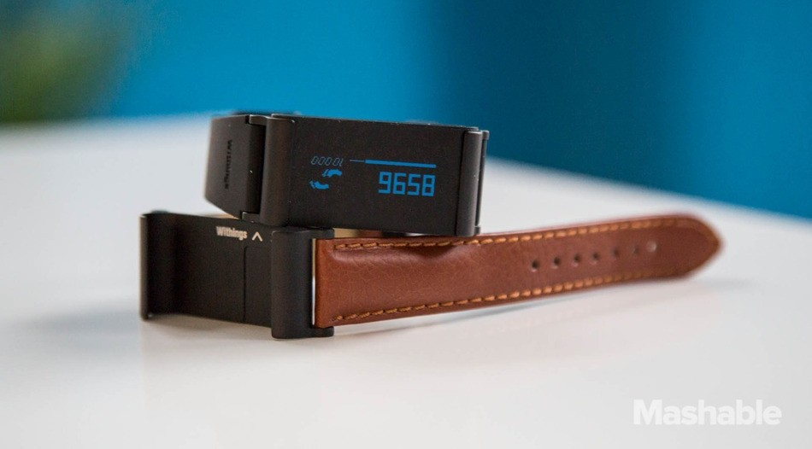

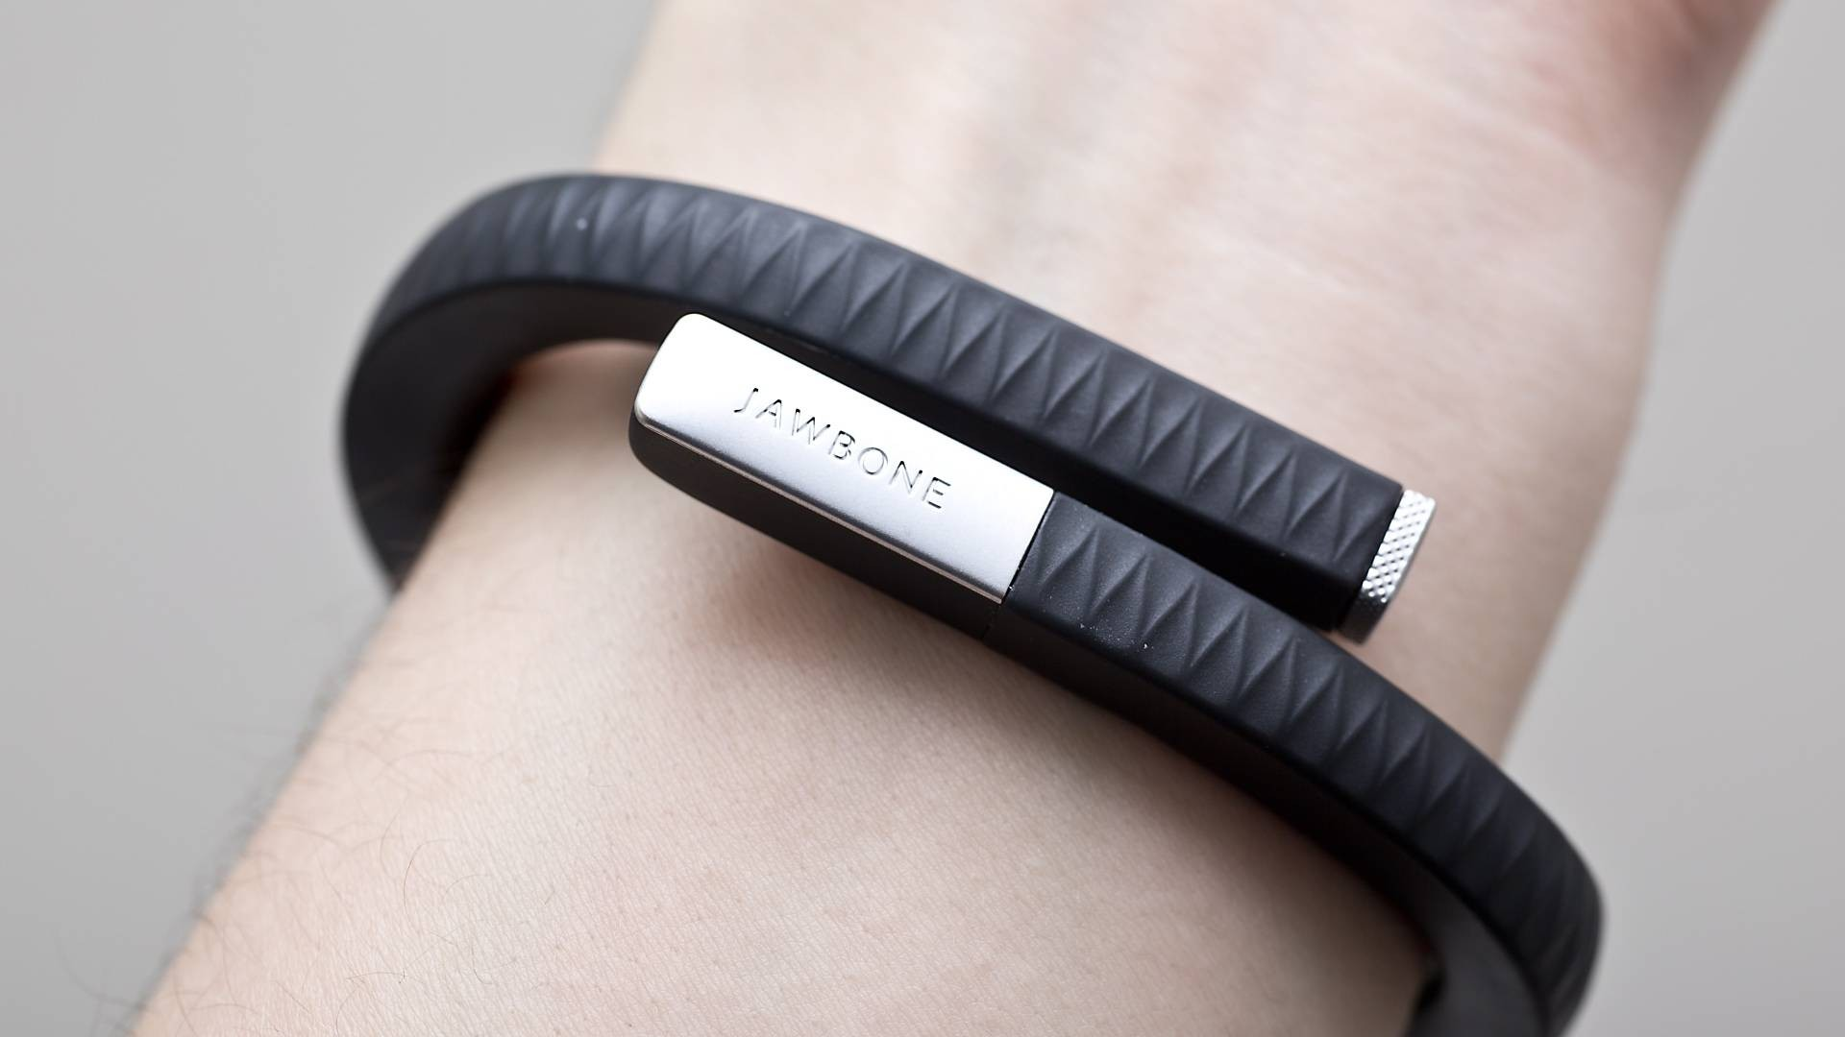
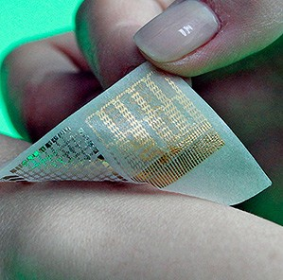
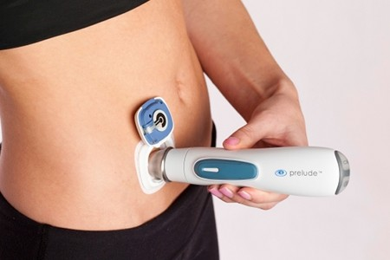
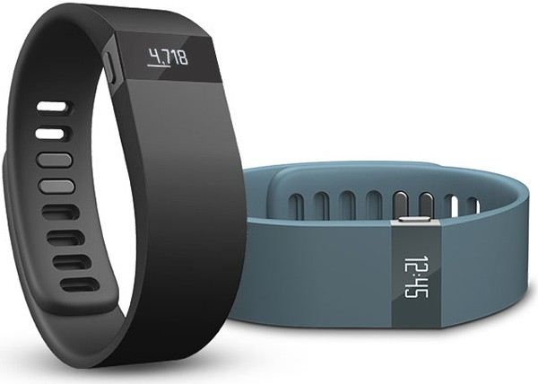

Slide 21
Implantables
Implantables have been around but are being redefined!
Possible vision correction & enhancement
Vital sign or blood glucose monitoring
Relay information back to Nurse Case Managers or Physician
Lots of diagnostic & monitoring potential

Slide 22
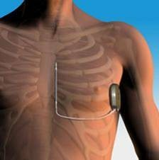
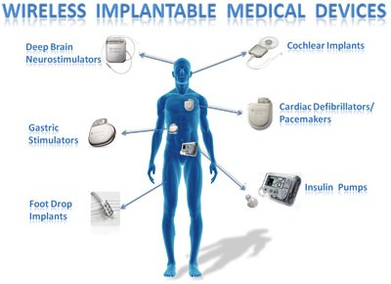

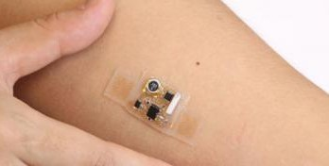
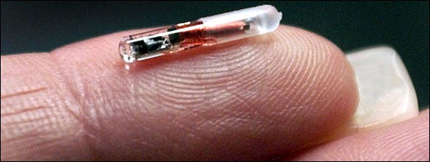

Slide 23

M-Vydya is key to Consumer driven
healthcare

Slide 24
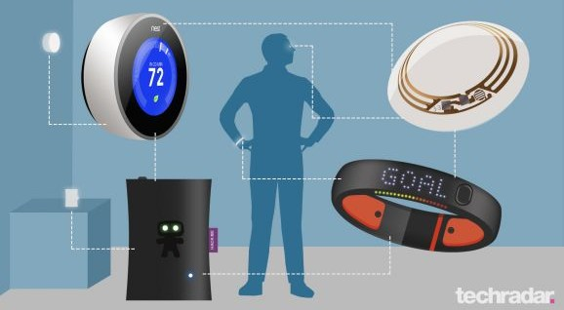

Slide 25


Slide 26
M-Vydya as part of a Technology Strategy……..
Technology is not the panacea for the healthcare industry…but it is part of the solution!

Slide 27
M-Vydya as part of a Technology Strategy
CIO creates technology strategy
Align with Strategic Plan
Balance clinical delivery needs with tech needs
Clinician input is essential
Evaluate value added m-vydya options

Slide 28
M-Vydya as part of a Technology Strategy…
Things to consider when evaluating m-vydya solutions:
Examine mobile strategy and potential for interoperability with EHR and enterprise systems.
Build a patient-centric model
Understand your care delivery model and if the solution is feasible

Slide 29
A special thanks to Amity university (raipur) and our mentor BAKTAWAR SIR for guidance and help .

Slide 30
CREW MEMBERS
SHUBHAM MANDAL
RAJ MALLICK
PARUL NARESH GOSWAMI
BISWAJIT RATH

